Slide 1



Traffic Accident Analysis
View in Power BI
Last data refresh:
6/16/2025 5:59:09 PM UTC
Downloaded at:
6/17/2025 4:21:30 AM UTC

Slide 2
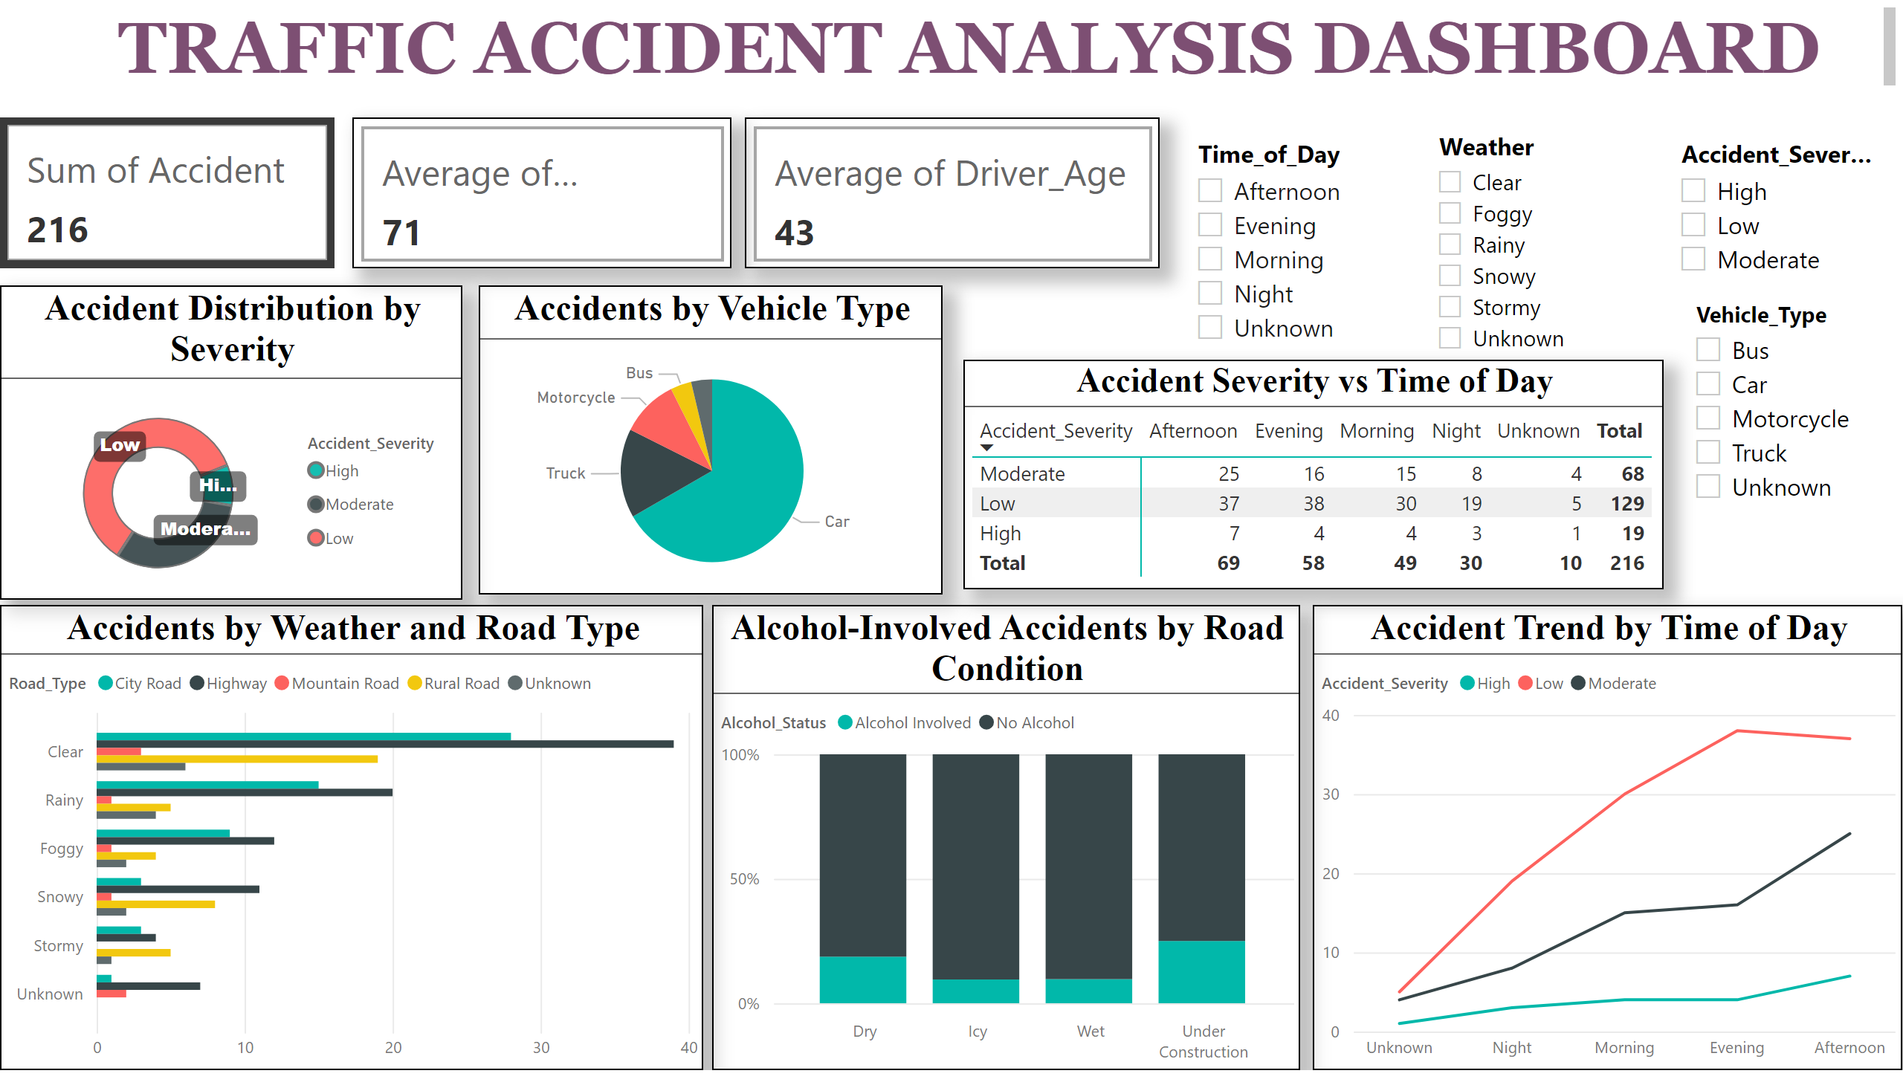
Page 1
Notes:
cardVisual
No alt text provided
Average Speed_Limit
No alt text provided
cardVisual
No alt text provided
Accident Distribution by Severity
No alt text provided
Accidents by Vehicle Type
No alt text provided
Accidents by Weather and Road Type
No alt text provided
Alcohol-Involved Accidents by Road Condition
No alt text provided
Accident Trend by Time of Day
No alt text provided
Accident Severity vs Time of Day
No alt text provided
slicer
No alt text provided
slicer
No alt text provided
textbox
No alt text provided
slicer
No alt text provided
slicer
No alt text provided

